Slide 1
Creative Bar Charts in PowerPoint
Webinar Exercise & Graphics Material

Slide 2


Hi! Peter, co-founder of infoDiagram here.
Enjoy this chart redesign practice guide and graphics.
I will appreciate your help – feedback and recommending our website to other people making presentations. If you have any questions, contact me: hello@infoDiagram.com
Read on… and get the special bonus we prepared for you at the end.

Slide 3
Chart mistakes to avoid & repairing them
Repeating information, lack of meaning and visual focus.

Slide 4
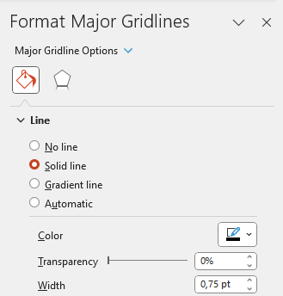
Chart Mistakes – Double information removal
To do:
Instruction: Remove one of the double information
Choose vertical axis values or values above bar chart. e.g. Click on the vertical axes values and hit Delete.
Click on horizontal gridlines and make them grey (use Shape Outline Color from Home menu) or remove them at all - hit Delete or in chart properties select No line.
Need help? Got feedback? See editing tips on our blog: blog.infodiagram.com/tips

Slide 5
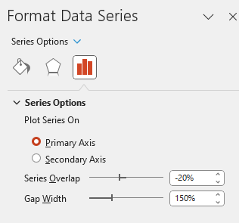
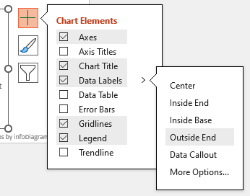
Chart rea– Bar width & look adjustments
To do:
Instruction:
A) Expand the bar width:
Click on the bar, with right mouse button, to open context menu. Select Format Data Series.
Adjust Series Overlap to -20%
and Gap Width to 150%
B) Update font: Select the whole chart. In the Home menu, change font e.g. to Calibri. Increase text size (shortcuts Ctrl+[ or Ctrl+] )
C) Adjust colors to focus on Budget category: Click on bar, choose color e.g. from menu Home or Chart Format: Shape Fill.
D) Adjust Data Labels position: Select Chart as whole, click on + sign on left, select Data Labels > Outside End

Slide 6
Enhancing chart design
Exercise task

Slide 7
Chart Makeover Goal:

Slide 8
Enhancing chart design: Illustrate data with icons
To do:
Instruction:
Copy icons from the next slide and arrange them over the chart in proper position, next to categories and title
Adjust icon colors, use Format painter if needed
Need help? Got feedback? See editing tips on our blog: blog.infodiagram.com/tips
Costs by driver
(% of Revenue)

Slide 9
Outline Icons Sample
Fully editable icons
More icons available.
Check our website
www.infodiagram.com

Slide 10
Enhancing design: Add background graphics
To do:
Instruction:
Adjust position of shapes under the chart.
Remove gridlines and category names by deleting them
Need help? Got feedback? See editing tips on our blog: blog.infodiagram.com/tips
Costs by driver (% of Revenue)
CAPEX
PEX
Other
OPEX

Slide 11
Enhancing design: Highlight key parts
To do:
Instruction:
Add markers - from this slide or another ones from the next slide. Paste them over value you want to highlight.
Adjust the marker size and/or its Shape Fill Color
Need help? Got feedback? See editing tips on our blog: blog.infodiagram.com/tips
CAPEX
PEX
Other
OPEX
Costs by driver (% of Revenue)

Slide 12
Sample of Hand-drawn Markers for Charts
Fully editable icons
More icons available.
Check our website
www.infodiagram.com

Slide 13
Elements for enhancing chart design
Place for comments
Header name
01
Write your title here…

Slide 14
Enhancing chart design: Final Bar Chart
CAPEX
PEX
Other
OPEX
Costs by driver (% of Revenue)

Slide 15
Bonus offer

Slide 16
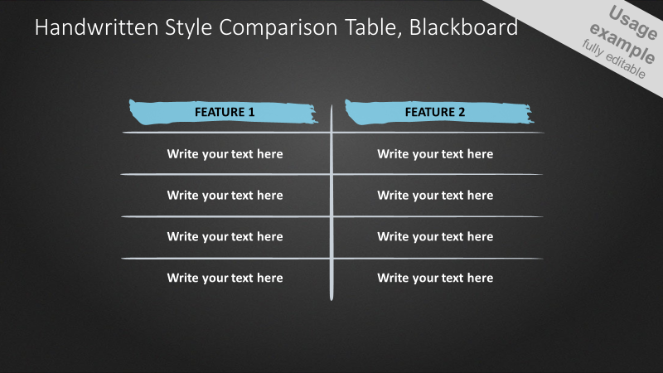

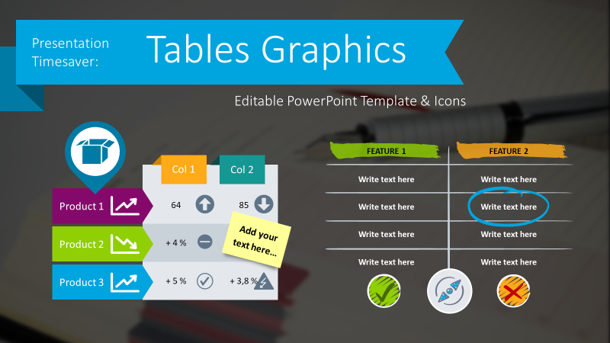
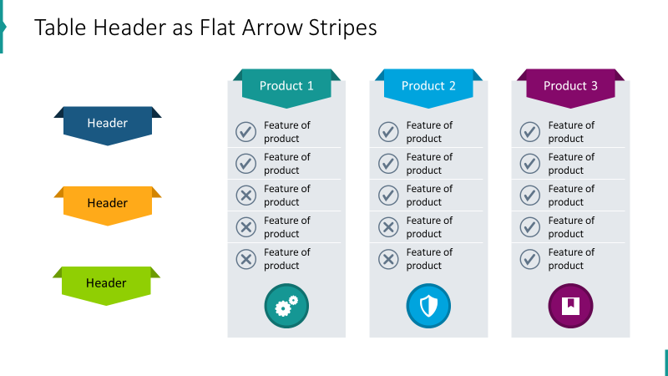
40%
off
Bundle of 3 PowerPoint presentation templates
78 charts
$85 deal now
(save $56)
only for a week,
till July 5
(click button below with Ctrl to open or copy the link below)
148 icons
$141 value
https://www.infodiagram.com/checkout/order?bundle=webinar-bar-charts-exclusive-promo

Slide 17
10%
off*
Or join our next Slide Design Training
*mention “webinar tables”
when emailing us
“Making Effective Visual Slides – advanced PowerPoint”
4 hours a day, over 3 days. July 17-18-19, 2023
Application deadline July 5, 2023
Details & sign-up
(click below with Ctrl to open or copy the link)
If any questions, contact me: hello@infoDiagram.com
https://sites.infodiagram.com/training_interested

