Slide 1
Dense Slides and Icons Power in PowerPoint
Webinar Tips & Graphics Material

Slide 2


Hi! Peter, co-founder of infoDiagram here.
Enjoy this dense slide redesign tips guide and graphics.
I will appreciate your help – feedback and recommending our website to other people making presentations. If you have any questions, contact me: hello@infoDiagram.com
Read on… and get the special bonus we prepared for you at the end.

Slide 3
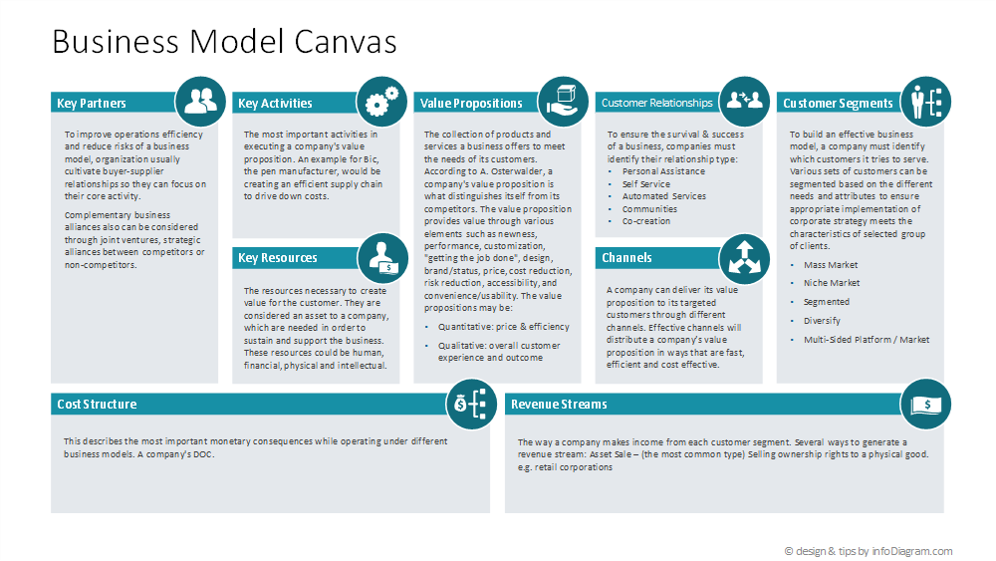
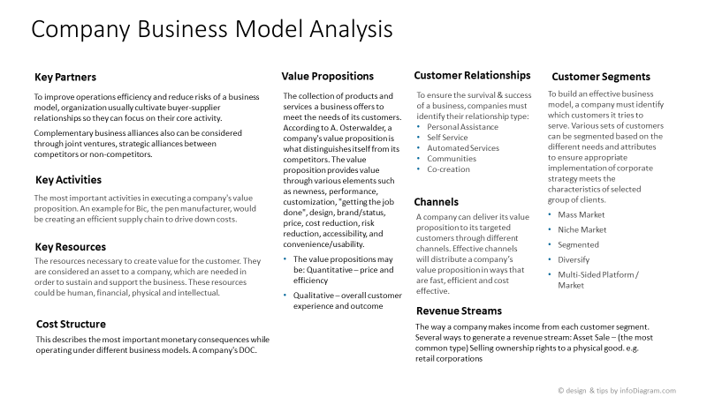
How to improve overcrowded slides?
Make them visual
Get more space
Use subtle background
Fit icons
Split slides
Shorten words
Replace font
Font size

Slide 4
Graphics for dense slides
Support Visual Thinking
= better understanding
Power
of icons
Universal
Easy to use
Remember:
Style Consistency

Slide 5
Graphical styles of icons
Remember:
Style Consistency
Outline style icons
Flat style icons
Scribble style icons

Slide 6
Design ways to add icons
As is
Recolor
Embed

Slide 7
Outline Icons Sample: Business, People, Ideas
Fully editable icons
More icons available.
Check our website
www.infodiagram.com

Slide 8
Bonus offer

Slide 9
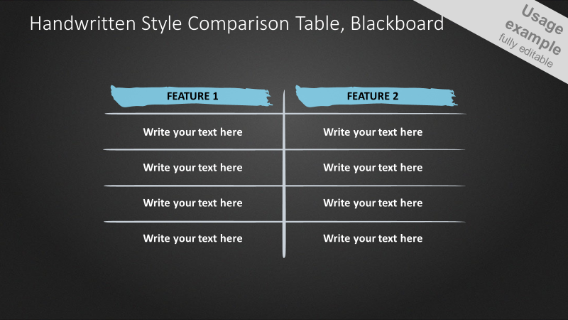

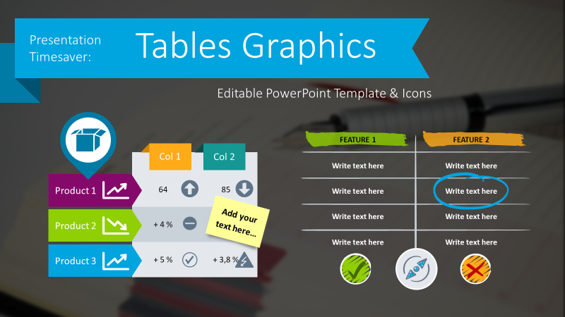

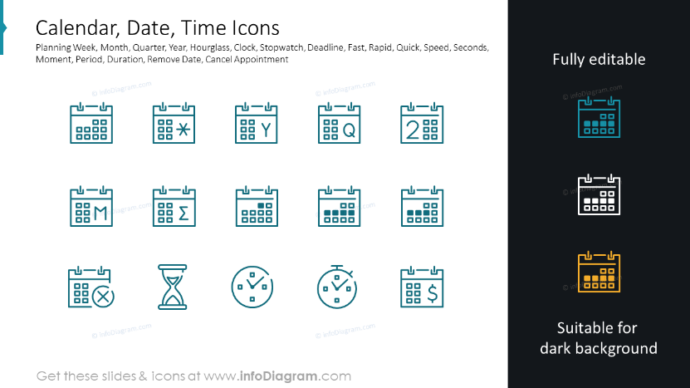

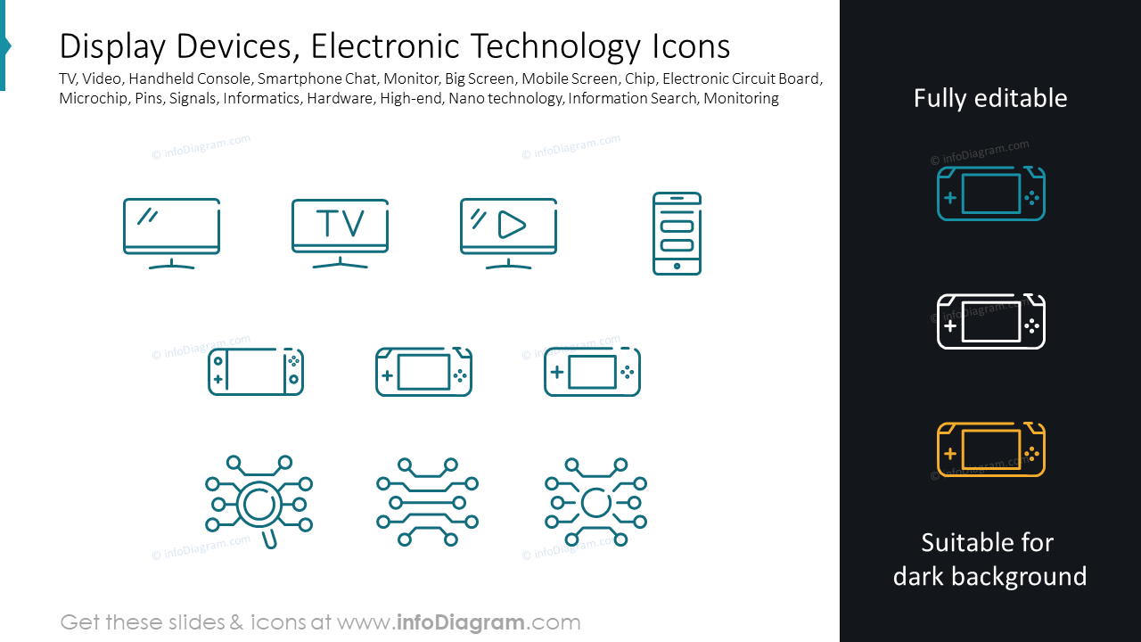
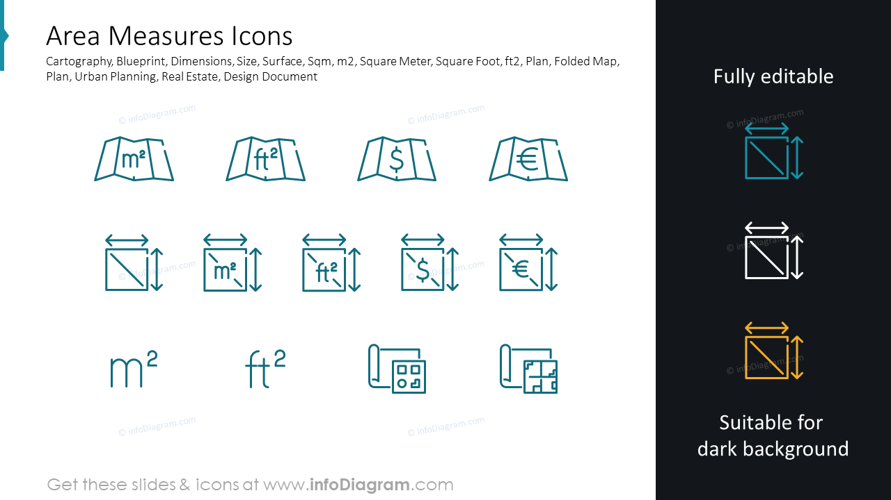
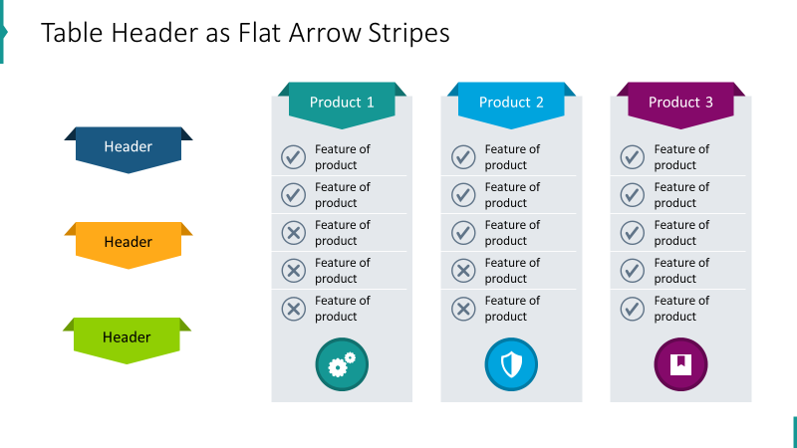
40%
off
Bundle of over 1000 outline business icons
1000+ vector icons
$137 deal now
(save $92)
only for a week,
till Sept 5
(click button below with Ctrl to open or copy the link below)
151 slides
$229 value
https://www.infodiagram.com/checkout/order?bundle=icons-webinar-bundle-exclusive-promo

Slide 10
10%
off*
Or join our next Slide Design Training
*mention “webinar icons”
when emailing us
“Making Effective Visual Slides – advanced PowerPoint”
4 hours a day, over 3 days. September 25-27, 2023 or Oct 23-25
Application deadline Sept 12, 2023
Details & sign-up
(click below with Ctrl to open or copy the link)
If any questions, contact me: hello@infoDiagram.com
https://sites.infodiagram.com/training_interested

