Slide 1
Prompting Notes Template
Editable template

Slide 2


Hi! Peter, co-founder of infoDiagram here.
Enjoy this template for making library of your own AI prompts.
I will appreciate your help – feedback and recommending our website to other people making presentations. If you have any questions, contact me: hello@infoDiagram.com
Read on…

Slide 3
How to use this AI prompting template
Add new prompt note - Create new slide for writing down new prompt case - shortcut: Ctrl+M
Choose alternative layout (top Menu: Layout) e.g.
  for longer prompts
  for result placeholder
  without comment
Search your prompts library - shortcut Ctrl+F
Organize prompt slides – use sections
  top menu View / Slide Sorter
  right mouse button click between slides and choose Add Section
Template by infoDiagram.com

Slide 4
Short prompt + result + comment template

Slide 5
Short prompt + result + comment template

Slide 6
Long prompt + comment template

Slide 7
Short prompt + result template

Slide 8
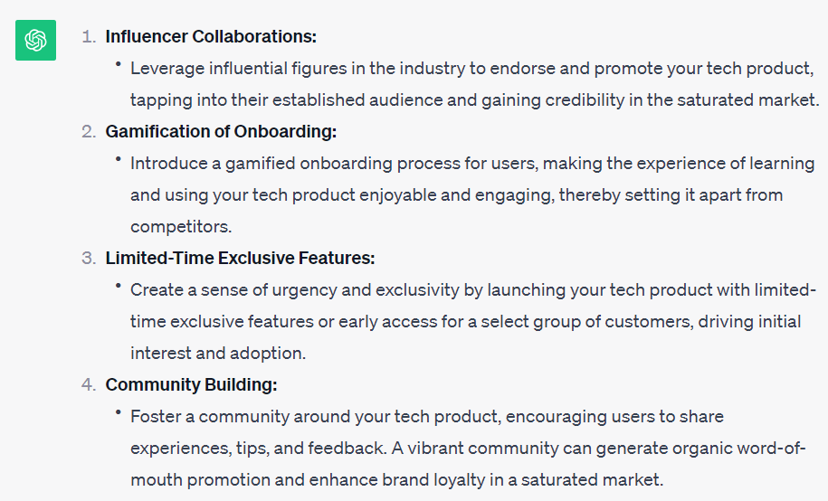
Example of Prompt Note
Give me 4 strategy ideas
for introducing new tech product on a saturated market?

Slide 9
Example prompt with Comment & Result Screenshot layout
Give me 4 strategy ideas
for introducing new tech product on a saturated market?
This was an experiment prompt for …
  testing ChatGPT vs Bard

Slide 10
Example of Prompt Note
Create a table with list of the biggest management consulting companies in UK and their size.
Add number of employees and revenue.

Slide 11
Example of Prompt Note
Create a table with list of the biggest management consulting companies in UK and their size.
Add number of employees and revenue.

Slide 12
Bonus offer

Slide 13
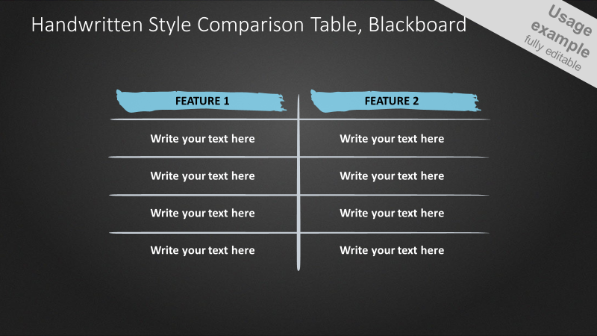

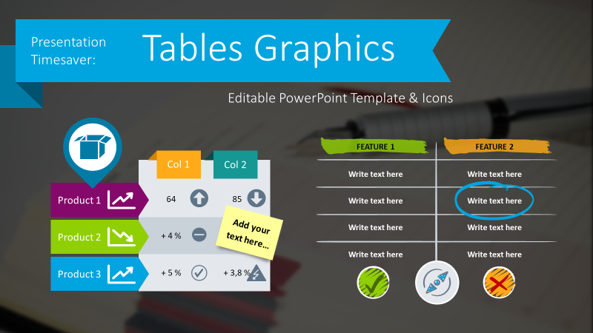

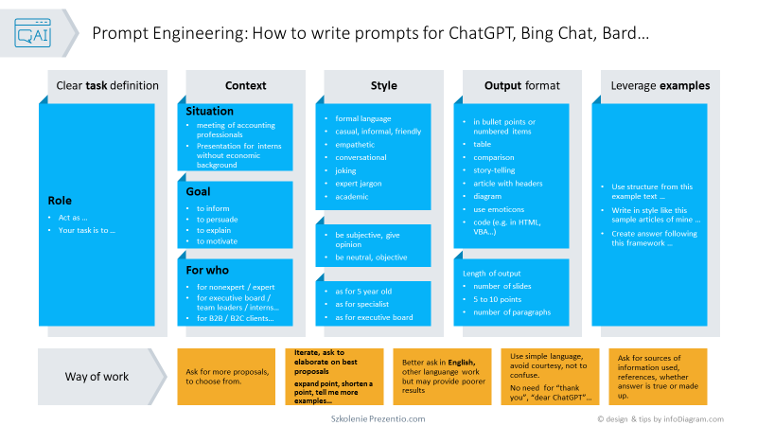
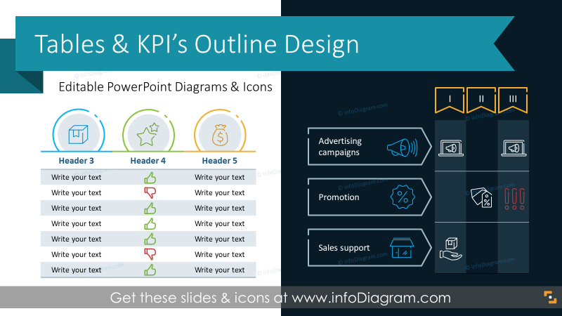
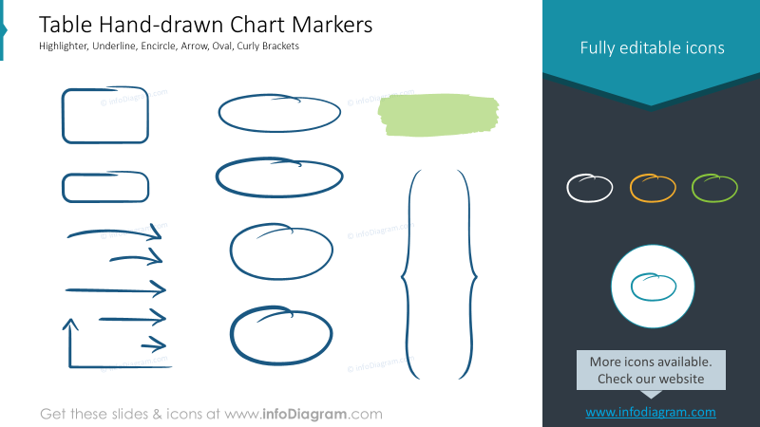
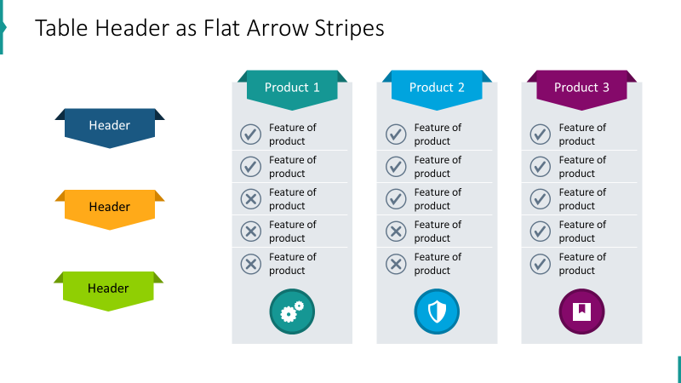
40%
off
Bundle of e-book and PPT table design graphics
e-book with how-to’s
& prompt cheat sheet
$53 deal now
(save $35)
only for a week,
till Dec 21
(click button below with Ctrl to open or copy the link below)
PPT graphics set
for tables design
$88 value
https://www.infodiagram.com/checkout/order?bundle=ai-ppt-webinar-bundle-exclusive-promo

Slide 14
Or join our next training
“Using ChatGPT with PowerPoint” Dec 22, online
“Making Effective Visual Slides – advanced PowerPoint”, online
Read more on our www.Prezentio.com website.
If any questions, contact us: hello@infoDiagram.com
Details & sign-up
(click below with Ctrl to open or copy the link)
https://prezentio.com/training-ppt-slide-design/

